Slide 1
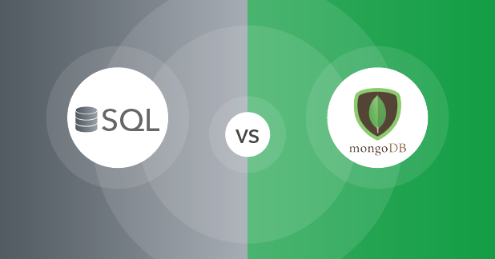

Slide 2
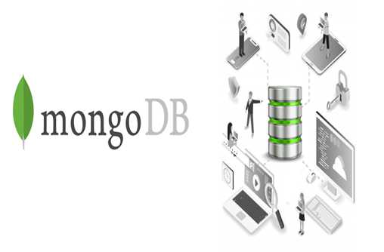
What is MongoDB
MongoDB is one of the most popular open-source NoSQL,MongoDB is a data management systheme used for handling, sorting and moving large amounts of information

Slide 3
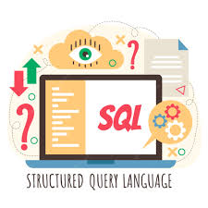
What is SQL
SQL is a standard language used for sorting, manipulating and retrieving data f

Slide 4
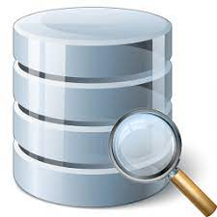
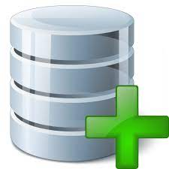
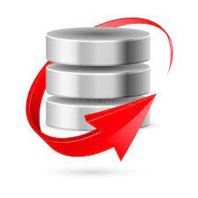
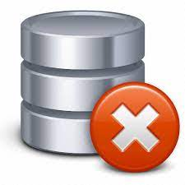
Functions of MongoDB
Read data from MongoDB database
Insert data to MongoDB database
Update data from MongoDB database
Delete data from MongoDB datbase

Slide 5
Functions of SQL
AVG()
LAST()
COUNT()
MAX()
FIRST()
MIN()
SUM()

Slide 6
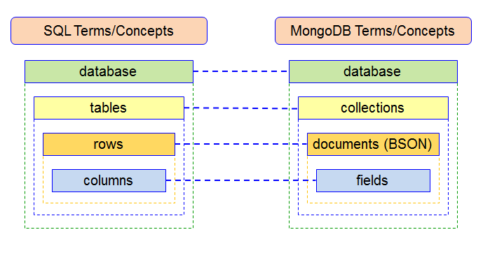
MongoDB VS SQL

Slide 7


VS
No relationnal (NoSQL)
Relational
Dynamic schemas
Predefined schema
Horizontally scalable
Vertically scalable
Document, key-value, graph, or wide-column stores
Table-based
Better for unstructured data like documents or JSON
Better for multi-row transactions

Slide 8
Thanks four your attention

